Slide 1
An Analysis of African Restaurants in New York City
BY
OLUWAFISAYO ADENIYAN

Slide 2
Introduction: Business Problem
JJK Enterprises is an African Based Company that want to set up a branch of the company in New York. However, there are some challenges that the company envisage they will experience in opening a branch in New York. One of the challenge is deciding the best neighborhood for their employees who will be relocating from Africa to stay in order to be able to get African delicacies. They are considering which borough in New York would be the appropriate place to set up their own African restaurant. Consequently, they have hired me to help them come up with solutions using my data science skills to make recommendations.
New York City (NYC), also known as the City of New York or simply New York (NY), is the most populous city in the United States. With an estimated 2018 population of 8,398,748 distributed over a land area of about 302.6 square miles (784 km2), New York is also the most densely populated major city in the United States.
The African population in New York has been growing steadily and therefore, this provides a business opportunity. Many Africans yearn for their own type of food and are willing to spend money when they visit any nearby African Restaurants to purchase African delicacies. Currently, there are not enough African Restaurants in New York to meet the needs of the African population and this represents a viable opportunity for food business owners or other stakeholders with interest in the food industry.
To take advantage of this business opportunity, JJK Enterprises an African based company set to open up an branch in New York city has decided to set up an African Restaurant in one of the Neighborhoods in New York. However, JJK Enterprises is not sure of the best location to set up this African Restaurant and has hired me to identify the best neighborhood to set up this African Restaurant.
This project is important because locating the best neighborhood to stay will determine to a large extent if the Africans relocating from Africa to New York will enjoy their experience while working in New York. Again, identifying the best location for JJK Enterprises to set up an African restaurant is essential for profitability.

Slide 3
Data
Data to be used includes the following:
New York city Data which contains borough, neighborhood, longitude and latitude will be obtained from New York City Data. The data will be cleaned, and then read it into a pandas data frame so that it is in a structured format.
New York Venue Categories Data which contains the African venues present in each of the neighborhoods in Toronto. I will use Foursquare API to explore the neighborhoods and extract the most common venue categories in each neighborhood.

Slide 4
Methodology
For this project I took the following steps:
Collected the New York city data from New York City Data.
Used FourSquare API we will find all venues for each neighborhood.
I Filtered out all venues that are African Restaurants.
I found rating , tips and like count for each African Resturants using FourSquare API.
I used rating for each restaurant and then sorted that data.
I visualized the Ranking of neighborhoods using folium library(python)

Slide 5
Analysis
For this project I took the following steps:
Collected the New York city data from New York City Data.
Used FourSquare API we will find all venues for each neighborhood.
I Filtered out all venues that are African Restaurants.
I found rating , tips and like count for each African Resturants using FourSquare API.
I used rating for each restaurant and then sorted that data.
I visualized the Ranking of neighborhoods using folium library(python)

Slide 6
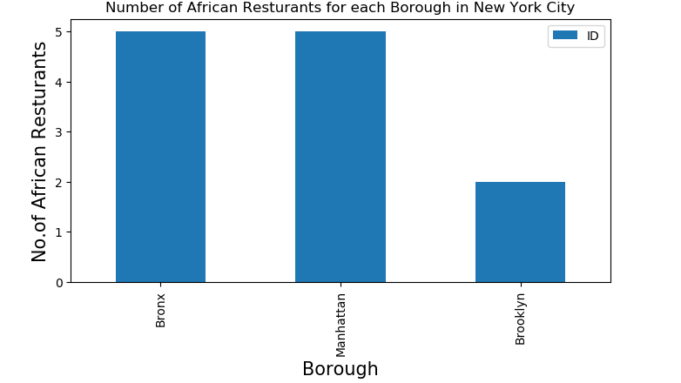
Results

Slide 7
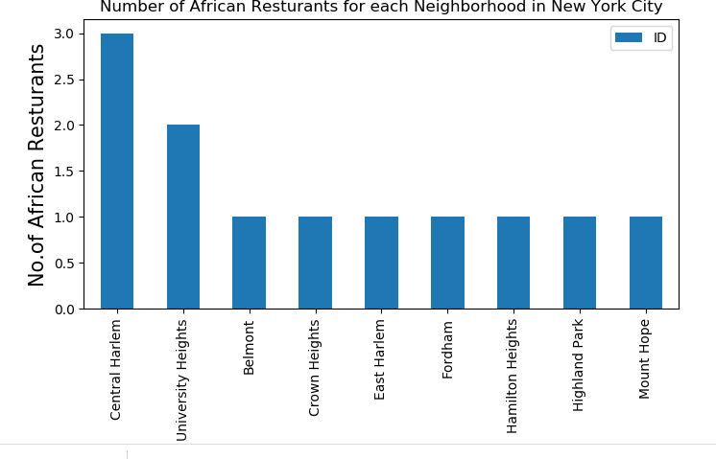
Results
Central Harlem has the highest number of African Restaurants

Slide 8
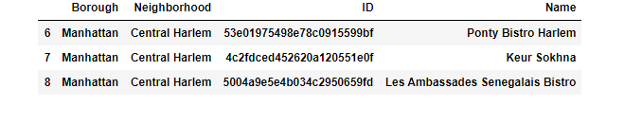
Results
Central Harlem in Manhattan has the highest number of African Restaurants with a total count of 3

Slide 9
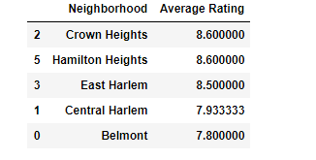
Results
Crown Heights and Hamilton Heights neighborhoods have the highest average rating.

Slide 10
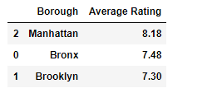
Results
Manhattan borough has the highest average rating.

Slide 11
Discussion
In all, there were a total of twelve African American restaurants in New York city and the three are located in the following boroughs: Bronx, Manhattan and Brooklyn.
The analysis shows that Bronx and Manhattan has the highest number of African Restaurants with each of them having five African restaurants. Although Brooklyn has the largest population of African Americans in New York, it still has fewer African Restaurants than Bronx and Manhattan. Therefore, setting up another African Restaurant in Brooklyn could prove to be a profitable venture.
In considering which location new employees of JJK Enterprises may stay, Central Harlem in Manhattan may prove to be a good choice since it has the highest number of African Restaurants. However, when considering the neighborhood with the best average rating, Crown Heights in Brooklyn and Hamilton Heights in Manhattan are the best locations to live in order to enjoy the best African delicacies. The results show that Crown Heights and Hamilton Heights had an average rating of 8.6.

Slide 12
Conclusion
In conclusion, my recommendation to JJK Enterprises is that they should take advantage of a potential business opportunity by setting up an African Restaurant in Brooklyn with its large population of Black and African Americans.
For their new employees coming from Africa, I recommend that they get accommodation in Central Harlem of Manhattan if they want to have more choices of African Restaurants. But for those of them that are place value of reviews and ratings, I would recommend they get accommodation in Crown Heights of Brooklyn or Hamilton Heights of Manhattan.

